Slide 1

Forecasting the Future: Sales Prediction through Data Cleaning and Insight Extraction
By
Mohanprasanth.S | Balachandru.S
BCA-DS | BCA-AI&ML

Slide 2
Abstract:
In today's data-driven business landscape, accurate sales forecasting is essential for strategic planning and decision-making. This presentation explores the importance of data cleaning and its impact on predictive analytics for sales forecasting. We leverage advanced data preprocessing techniques to handle missing values, remove duplicates, and ensure data consistency. Using historical sales data, we implement an ARIMA-based time series forecasting model to predict future sales trends. The analysis provides valuable insights into seasonal variations, top-selling products, and high-performing cities. By integrating data visualization and machine learning, this approach enables businesses to make informed decisions, optimize inventory management, and enhance revenue projections.
Keywords:
➤ Data Cleaning ➤ Sales Forcasting
➤ Predictive Analysis ➤ ARIMA model
➤ Timeseries Analysis ➤ Business Insights
➤ Machine Learning ➤ Trend Analysis

Slide 3
Tools Used:
In this project, multiple tools and technologies were utilized to clean, analyze, visualize, and forecast sales data effectively.
1. Python – Data Cleaning & Analysis
Used for data preprocessing, including handling missing values, removing duplicates, and data transformation.
Performed Exploratory Data Analysis (EDA) to identify trends and patterns.
Implemented the ARIMA model for time series forecasting to predict sales for the upcoming year.
2. MySQL – Database Management
Used as the primary database for storing raw and processed sales data.
Enabled efficient data retrieval and management through SQL queries.
3. Power BI – Business Performance Dashboard
Created interactive dashboards to visualize sales trends, revenue distribution, and key business insights.
Provided real-time analytics to support data-driven decision-making.
4. Excel – Data Storage & Filtering
Stored cleaned and processed data in structured formats.
Used for data filtering and summarization before further analysis and visualization.

Slide 4
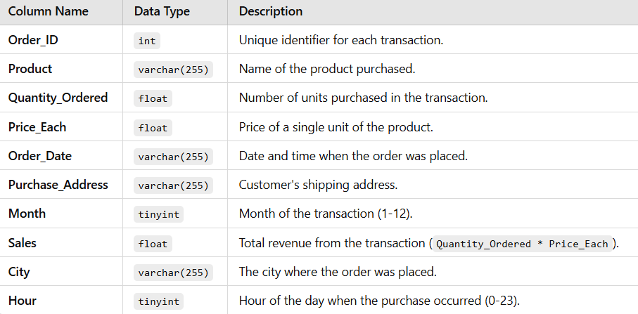
Database Overview:
The “sales_data” table is a structured dataset used for analyzing sales trends and forecasting future revenue. It stores transactional details, including product sales, purchase locations, and timestamps, which are essential for business insights.
Dataset Explanation:

Slide 5
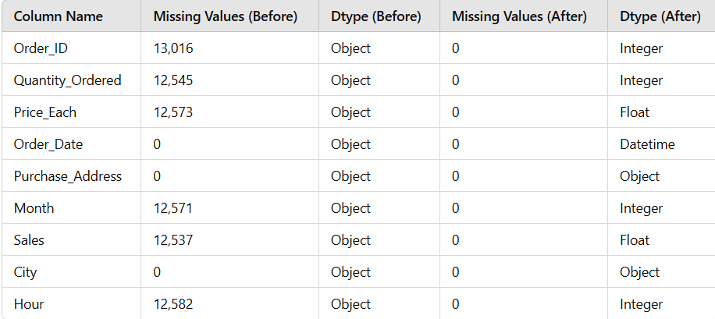
Data Cleaning in Python
In this step, we clean and preprocess the sales data by handling missing values , removing duplicates
and ensuring proper data formatting. This process enhances data accuracy, consistency, and reliability for effective analysis and forecasting.
Before and After Data Cleaning
Key Data Cleaning Steps:
✔ Handling Missing Values – Filled missing numerical values using the mean method. ✔ Removing Duplicates – Eliminated redundant records to maintain data integrity. ✔ Data Type Conversion – Converted Order_Date to datetime format for time series analysis. ✔ Feature Engineering – Extracted Month and Year-Month from Order_Date for better forecasting. ✔ Outlier Detection & Treatment – Identified and managed extreme values to prevent data skewness.

Slide 6
Data Manipulation
After cleaning the dataset, sorting and filtering techniques were applied to extract key sales trends and patterns, ensuring data-driven insights for business decisions.
Key Data Manipulation Steps:
✔ Ranking Cities by Sales Performance
Sorted cities by total sales to identify top revenue-generating locations.
Provided insights into regional demand and market strength.
✔ Determining Best-Selling Products in Each City
Filtered sales data to pinpoint the most purchased product per city.
Helped understand customer preferences and localized demand patterns.
✅ These transformations enable effective sales analysis and forecasting, helping businesses optimize strategies for different markets. 🚀

Slide 7
Exploratory Data Analysis (EDA) – Visual Insights
To gain deeper insights into sales trends and relationships, six key visualizations were created. These charts help in understanding sales performance, customer behavior, and key influencing factors.
📌 Key Insights:
1️⃣ Correlation Matrix: Shows the relationships between numerical variables like sales, quantity, and price to identify key influencing factors.
2️⃣ Top 10 Best-Selling Products: Helps understand which products drive the most revenue, aiding in stock management and marketing strategies.
3️⃣ Monthly Sales Trend: Highlights seasonal sales variations, enabling better demand forecasting.
4️⃣ Top 5 Revenue-Generating Cities: Identifies high-performing locations, supporting expansion and regional marketing efforts.
5️⃣ Top-Selling Product in Each City: Pinpoints the most preferred products per location, aiding in personalized customer targeting.
6️⃣ Peak Sales Months: Reveals the months generating the highest revenue, guiding promotional and inventory strategies.

Slide 8
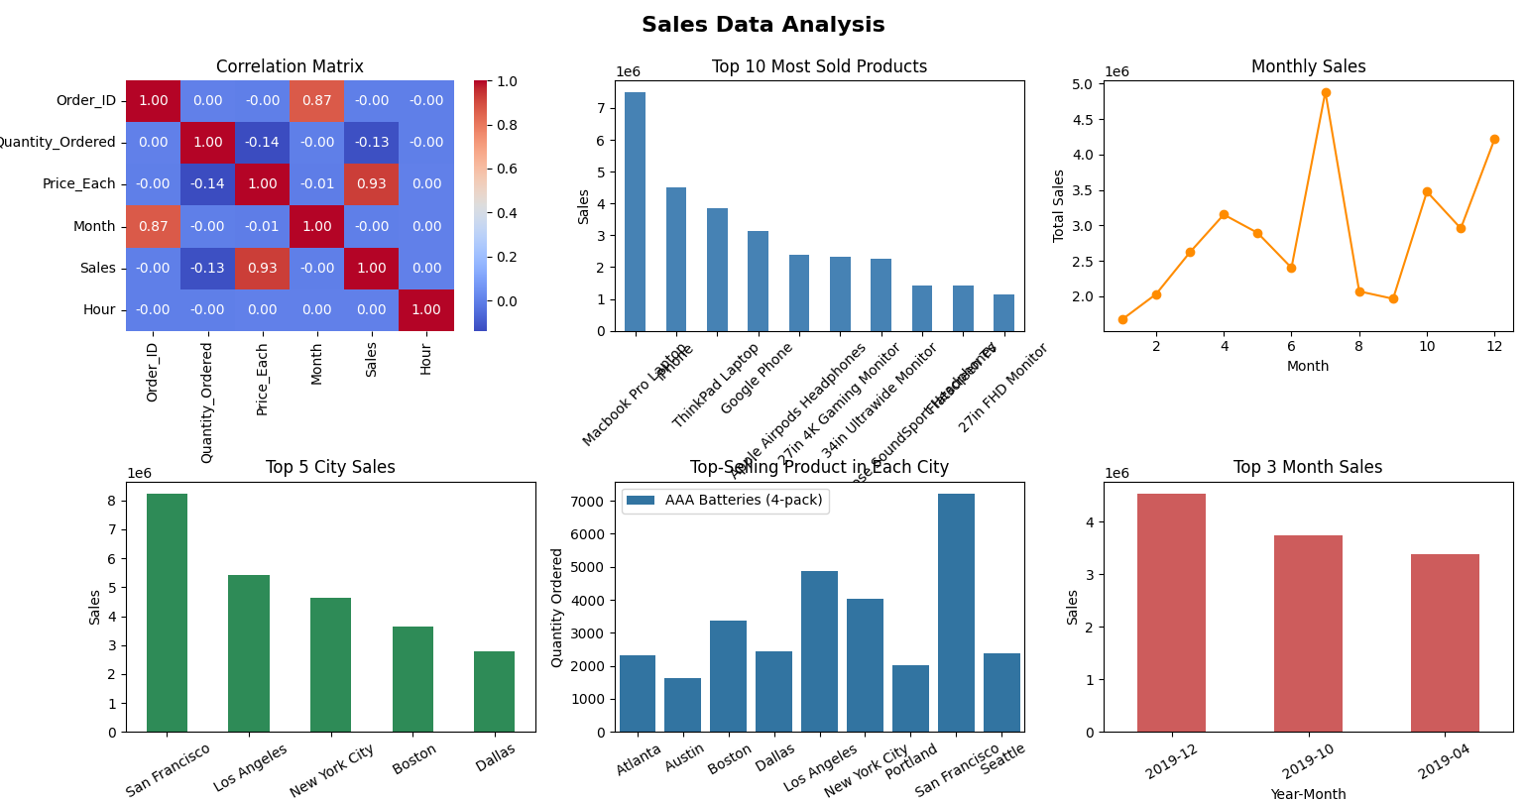

Slide 9
Power BI Sales Data Analysis
Power BI is a powerful business intelligence tool used for data visualization, reporting, and interactive analysis. In Sales Data Analysis, it helps businesses uncover trends, track performance, and optimize strategies through real-time insights.
📊 Key Insights & Analysis:
1️⃣ Sales Performance Overview – Track total revenue, quantity sold, and customer distribution.
2️⃣ Time-Series Analysis – Identify seasonal trends and peak-performing months.
3️⃣ Product Performance – Determine top-selling products and their revenue contribution.
4️⃣ Geographical Insights – Analyze sales distribution across cities to optimize market strategies.
📈 Business Impact:
✅ Data-Driven Decision Making – Improve pricing, marketing, and sales strategies.
✅ Operational Efficiency – Optimize inventory and supply chain based on demand fluctuations.
✅ Customer Insights – Understand regional preferences for targeted campaigns.

Slide 10
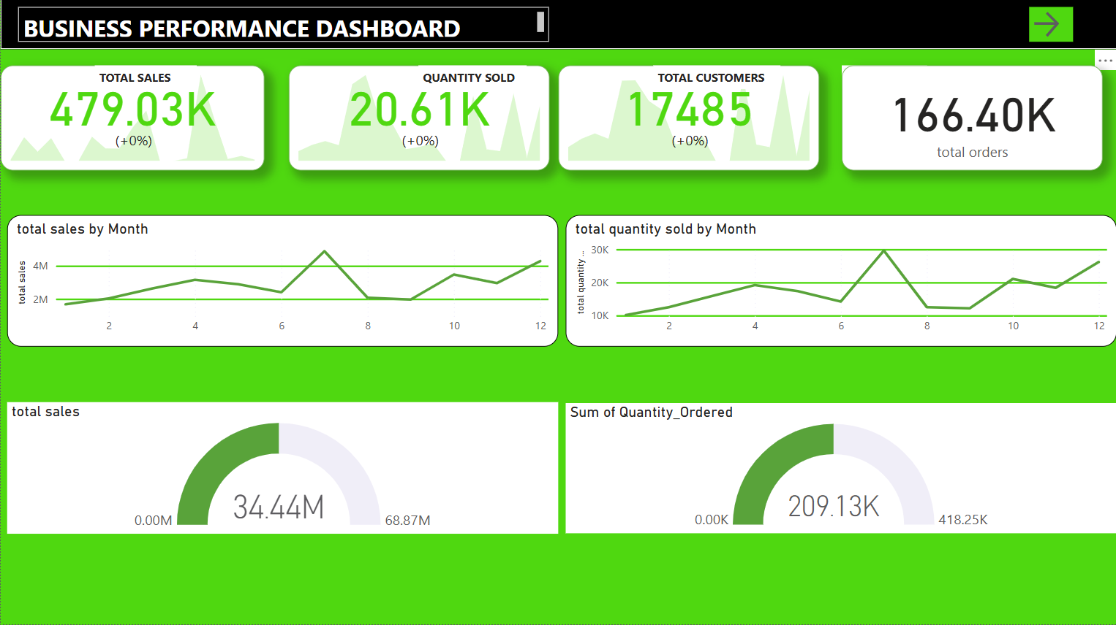

Slide 11
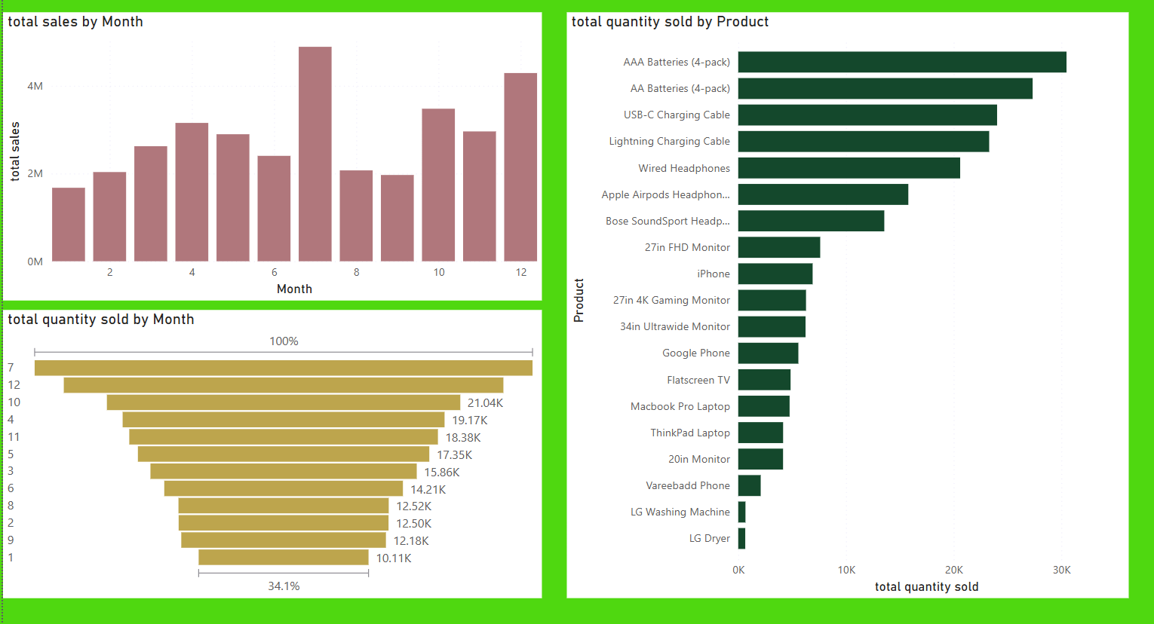

Slide 12
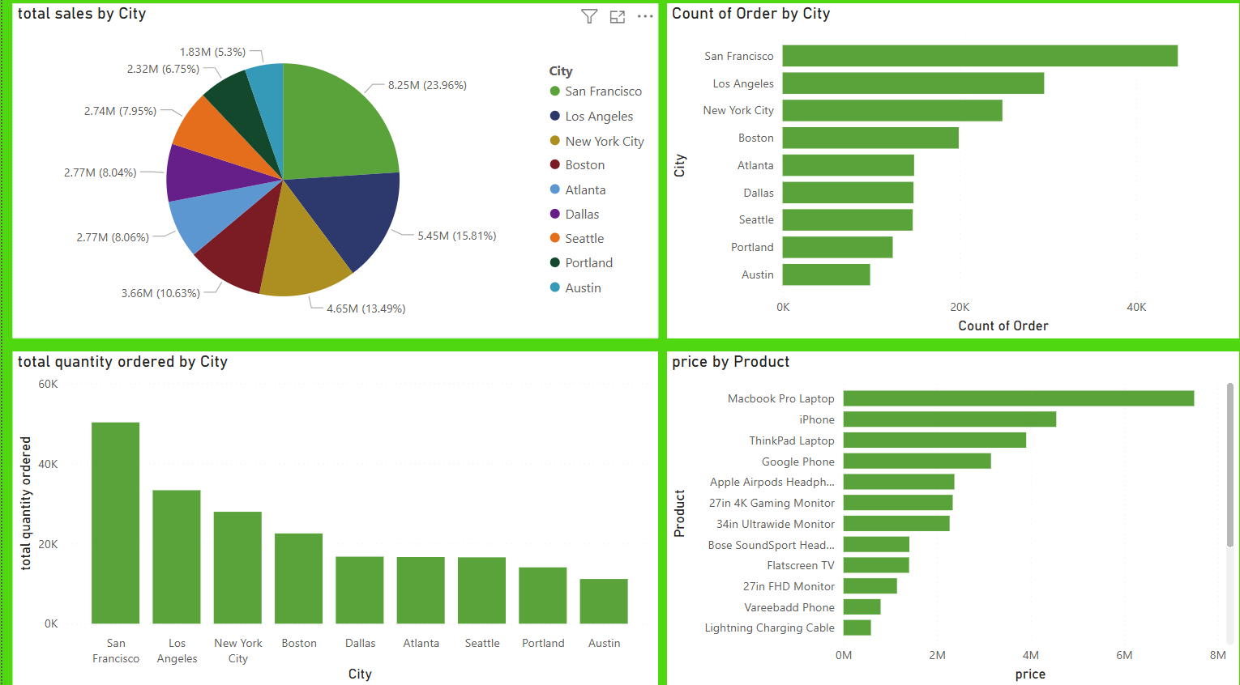

Slide 13
Sales Forecasting
🔹 Goal: Predict future sales trends using past data and ARIMA modeling.
🔹 Steps Taken:
✔ Collected and cleaned monthly sales data for accuracy.
✔ Used the ARIMA model to identify patterns and trends.
✔ Optimized model parameters to improve prediction accuracy.
✔ Forecasted sales for the next 12 months based on past trends.
✔ Compared actual vs. predicted sales to evaluate performance.
✔ Achieved 86% accuracy (R² = 0.86), ensuring reliable insights..
🔹 Why It’s Useful:
✅ Better Planning: Helps in managing stock and demand.
✅ Smart Decisions: Supports pricing and marketing strategies.
✅ Risk Reduction: Prepares for sales fluctuations in advance.

Slide 14
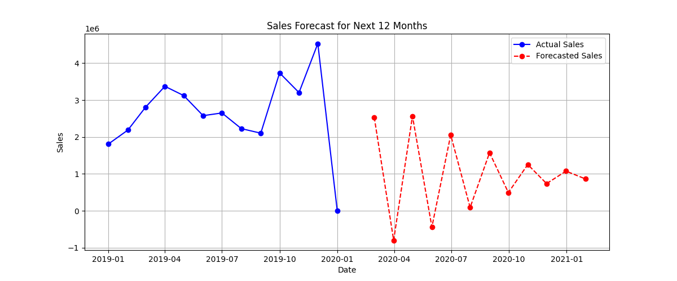
Output
📊 Graph Interpretation: 🔵 Blue Line → Actual Sales (Past Data) 🔴 Red Dotted Line → Forecasted Sales (Predicted for Next 12 Months)
🔹 Key Takeaways: ✔ Observes historical trends and future sales estimates. ✔ Identifies seasonal patterns and fluctuations. ✔ Helps businesses plan inventory, pricing, and marketing strategies efficiently.

Slide 15
Thank You

